Slide 1

Behind the Screen: The Damaging Effects of Algorithmic Bias on Social Media
Group 7:
Harshitha Peddi
Manikya Deepika Eadara
Taravat Ashabi

Slide 2

Agenda
Introduction
Problem Statement
Aim of the project
Approach for the project
Used Technologies
Results
Future work

Slide 3
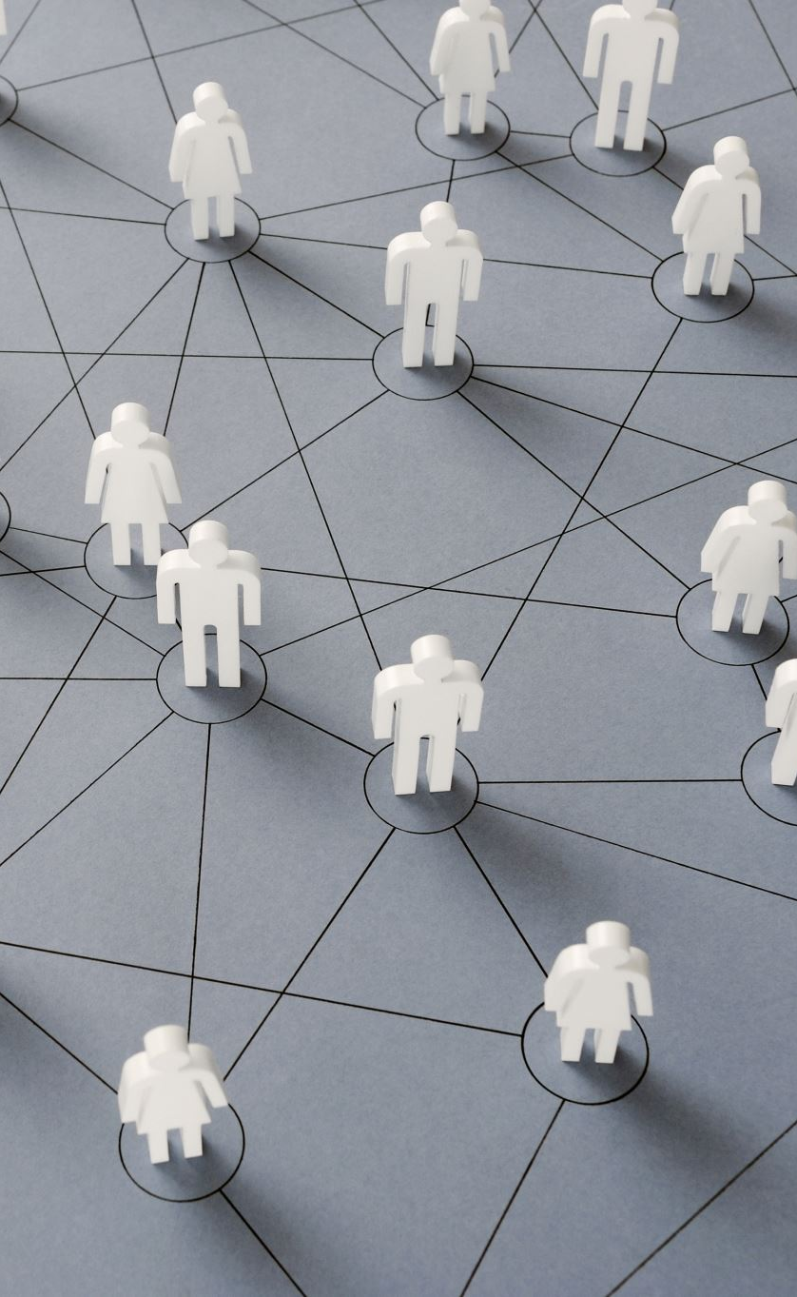
Introduction
Usage and accessibility of social media platforms have consistently increased.
People desire to be on various social media platforms as they see it as their ability to stay interconnected with their online community.
The fear of missing out drives people to spend more time on social media to stay up to date on current events.

Slide 4
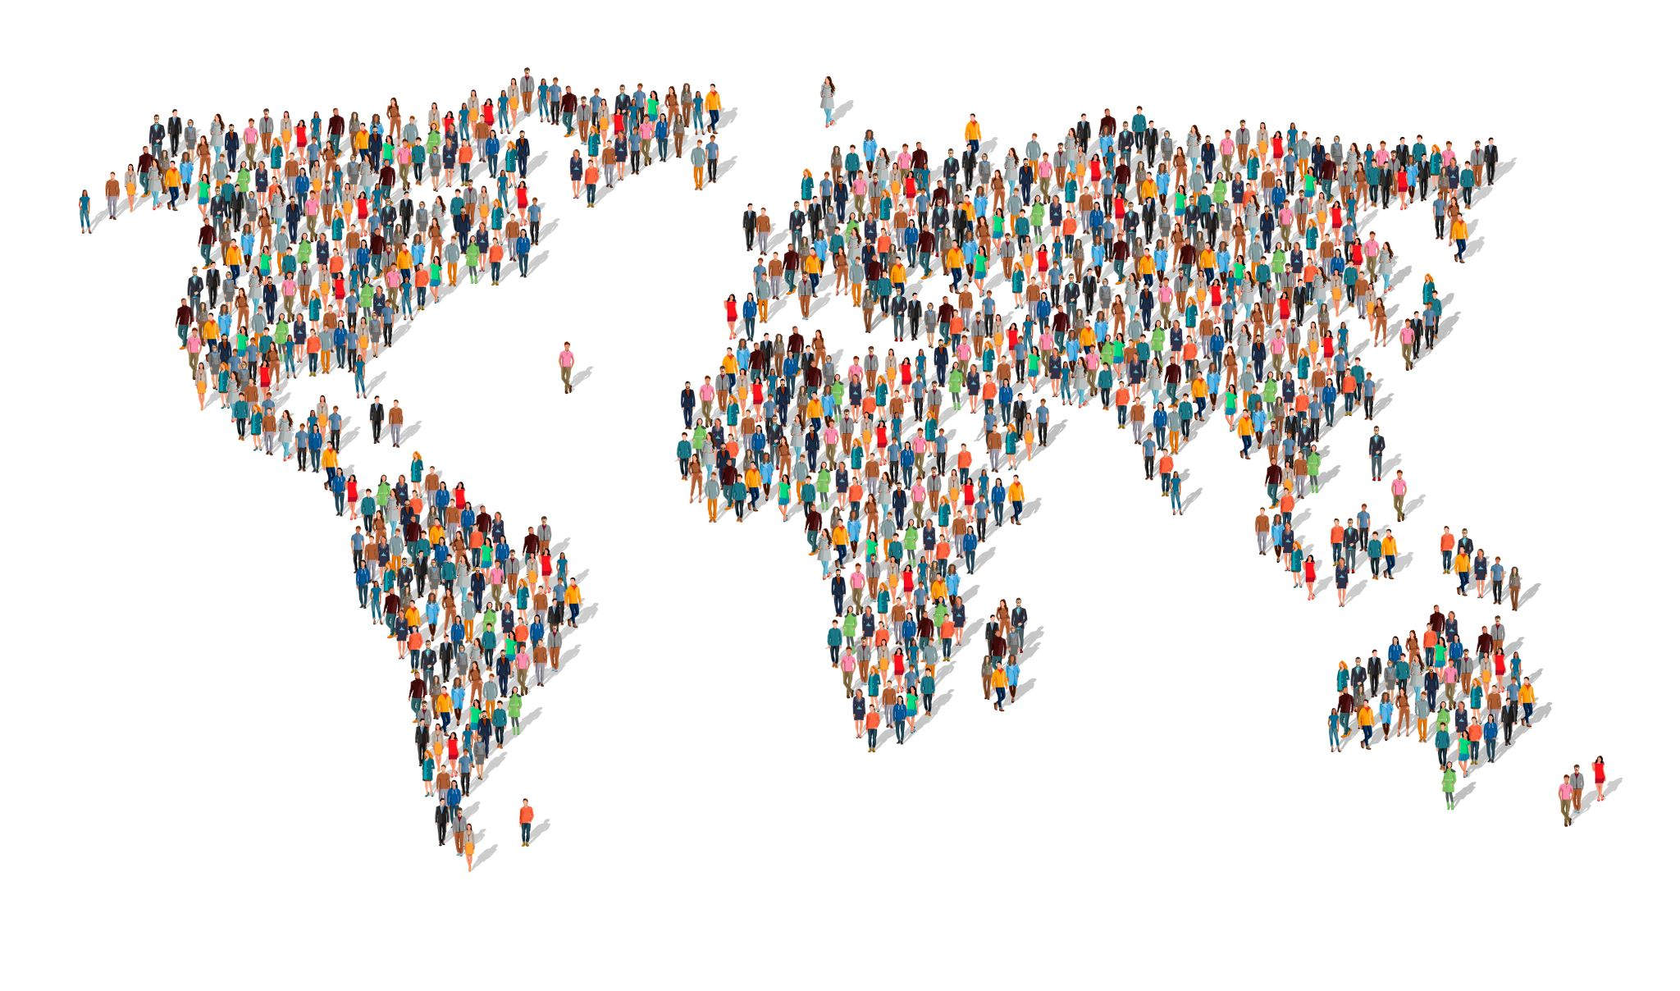
Problem Statement
People all around the world are spending hours daily on different social media platforms. The main problem is to investigate the impact of excessive social media use on users' mental and physical health, addressing the persistent concerns about this issue.

Slide 5

Aim of the project
To investigate the connection between social media usage and its impacts on peoples’ personal lives.
Personal handheld devices and the widespread use of social media platforms have caused people to spend more time on their smartphones, leading to concerns about the impact of social media on emotional, mental, and physical well-being.

Slide 6

Approach for the project
Data cleaning and preprocessing
Exploratory data analysis
Data modeling
Data visualization

Slide 7

Used Technologies
Python: used to preprocess the data.
Tableau: used to provide appropriate visualizations for responding to the research questions

Slide 8
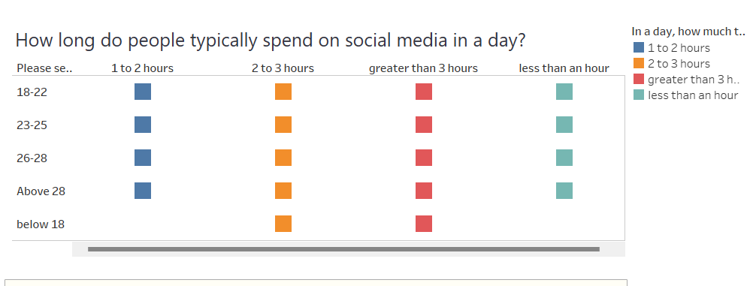
Results
Research Question 1

Slide 9
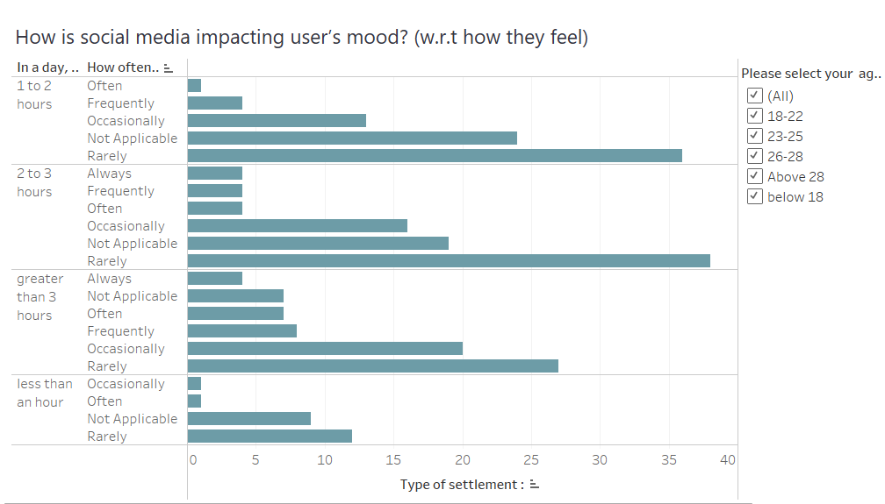
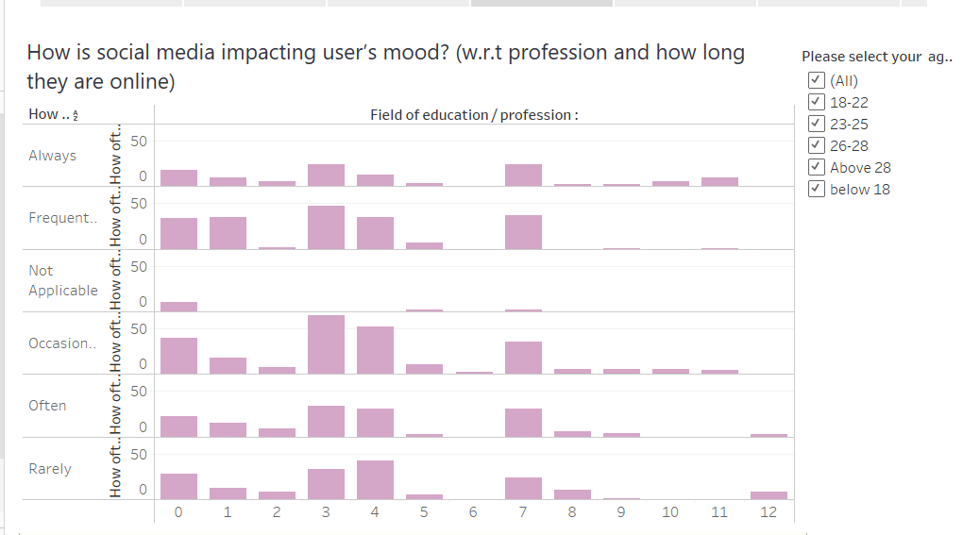
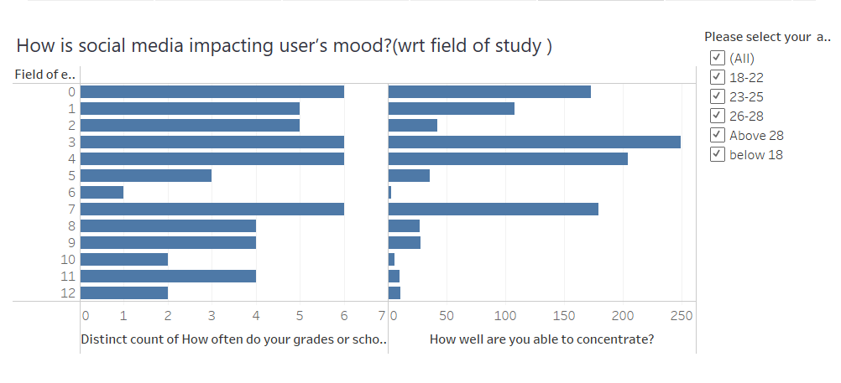
Results
Research Question 2

Slide 10
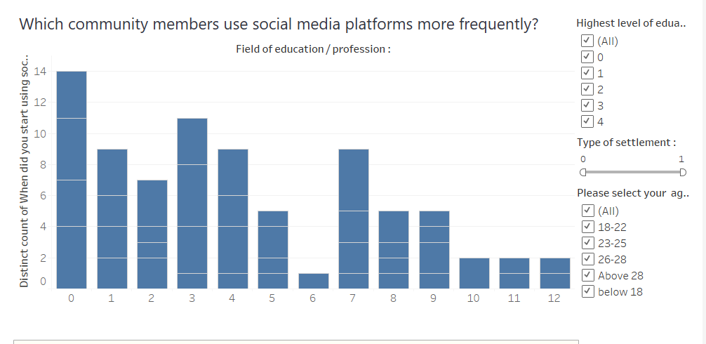
Results
Research Question 3

Slide 11
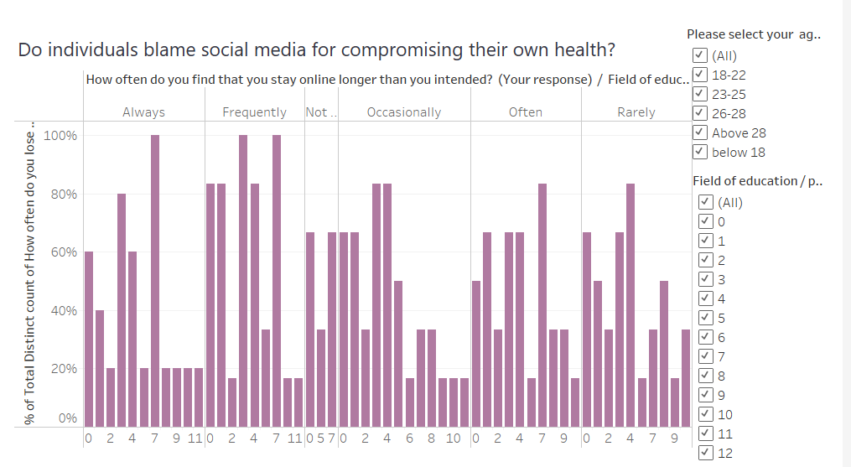
Results
Research Question 4

Slide 12
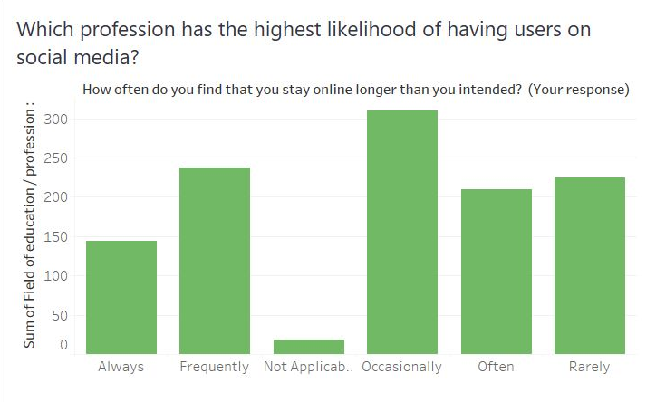
Results
Research Question 5

Slide 13

Future Work
Diving into social media's impact on work-life balance and career moves
Testing the effectiveness of digital wellbeing tools
Measuring the success of teaching responsible social media use
Studying the role of social media algorithms in mental health
Finding ways to fight social media's negative effects

Slide 14

Any questions?

Slide 15

Thank You

